Slide 1
EGT309 Presentation
By: Derek, Shun Wei, Wei Guan

Slide 2
EDA WALKTHROUGH
Temperature: replaces unrealistic values (>60°C) with NaN, then median imputation
Humidity: replaces physically impossible values (< 0 or > 100%) with NaN, then median imputation
CO2_InfraredSensor: clips negative values (sensor calibration error, min -17.47 ppm) to NaN, then median imputation
CO2_ElectroChemicalSensor: no missing or anomalous values found
CO_GasSensor: mode imputation for missing values (8.3% missing), cast to integer — values range 0–4 (not binary)
MetalOxideSensor_Unit2: median imputation (14% missing; other units have 0 missing)
HVAC Operation Mode: standardised 23 inconsistent variant spellings into 6 canonical lowercase_underscore categories
Activity Level: standardised 6 variant spellings into 3 canonical forms (Low Activity, Moderate Activity, High Activity)
Ambient Light Level: 10.5% missing — diagnosed missing pattern (MCAR across Time of Day / HVAC modes), imputed with mode (very_bright) to avoid dropping 10% of rows
Time of Day: 4 consistent categories (morning, afternoon, evening, night), no missing or casing issues
Session ID: unique row identifier (10000/10000 unique), no predictive value — dropped during modeling

Slide 3
Feature vs. Target Analysis
Examines how each feature relates to the Activity Level target:
Numeric sensor distributions by activity class (box plots)
Full correlation matrix across all sensors + target
Categorical cross-tabulations (HVAC mode, Time of Day, Ambient Light, CO_GasSensor vs. Activity Level)
Key finding: Metal Oxide sensors and CO2_ElectroChemicalSensor have the strongest predictive signal; Temperature and Humidity have near-zero correlation with the target

Slide 4
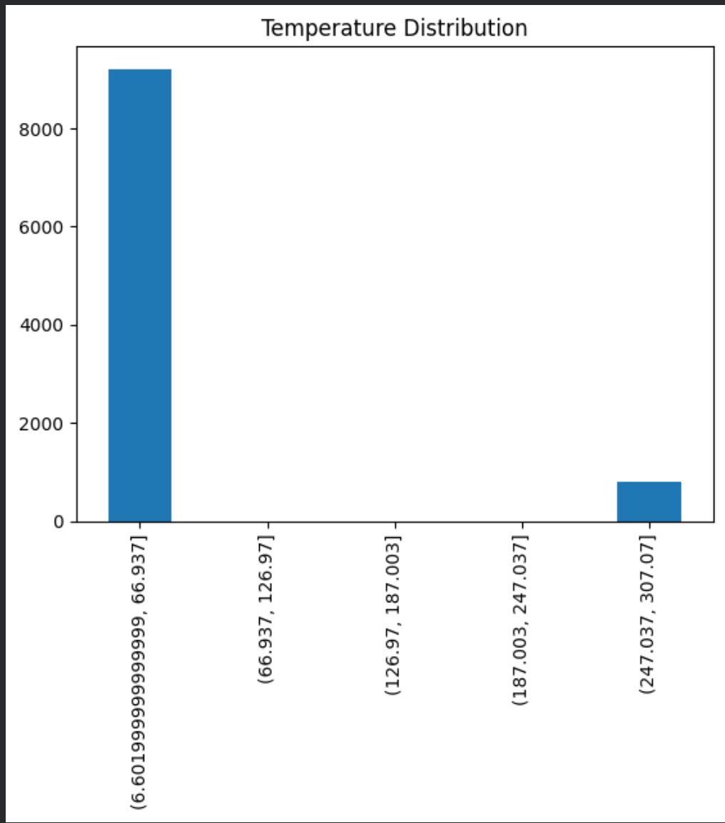
Temperature
This bar chart displays a "Temperature Distribution" across five distinct temperature ranges, showing a highly bimodal or polarized dataset. The vast majority of the data points—over 9,000 counts—fall into the lowest temperature interval between approximately 6.60 and 66.94. Conversely, there is a small secondary cluster of around 800 counts in the highest temperature range (247.04 to 307.07), while the middle temperature intervals contain virtually no data.

Slide 5
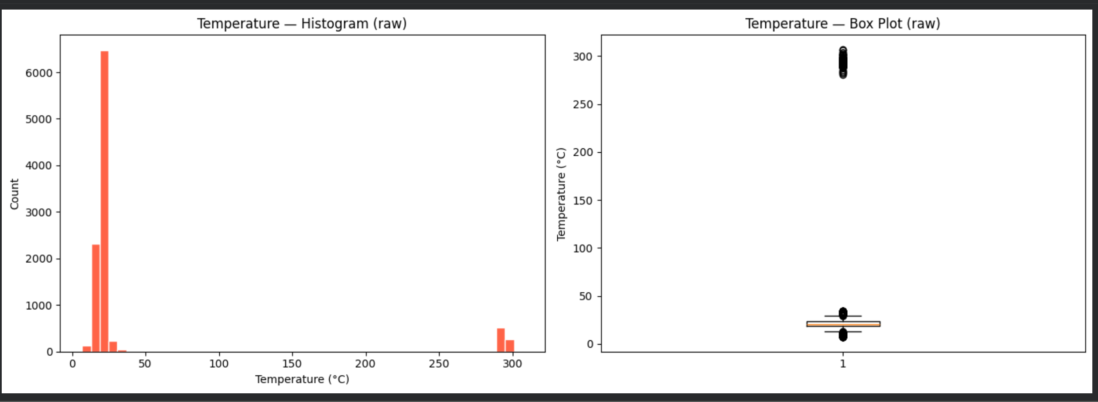
Temperature

Slide 6
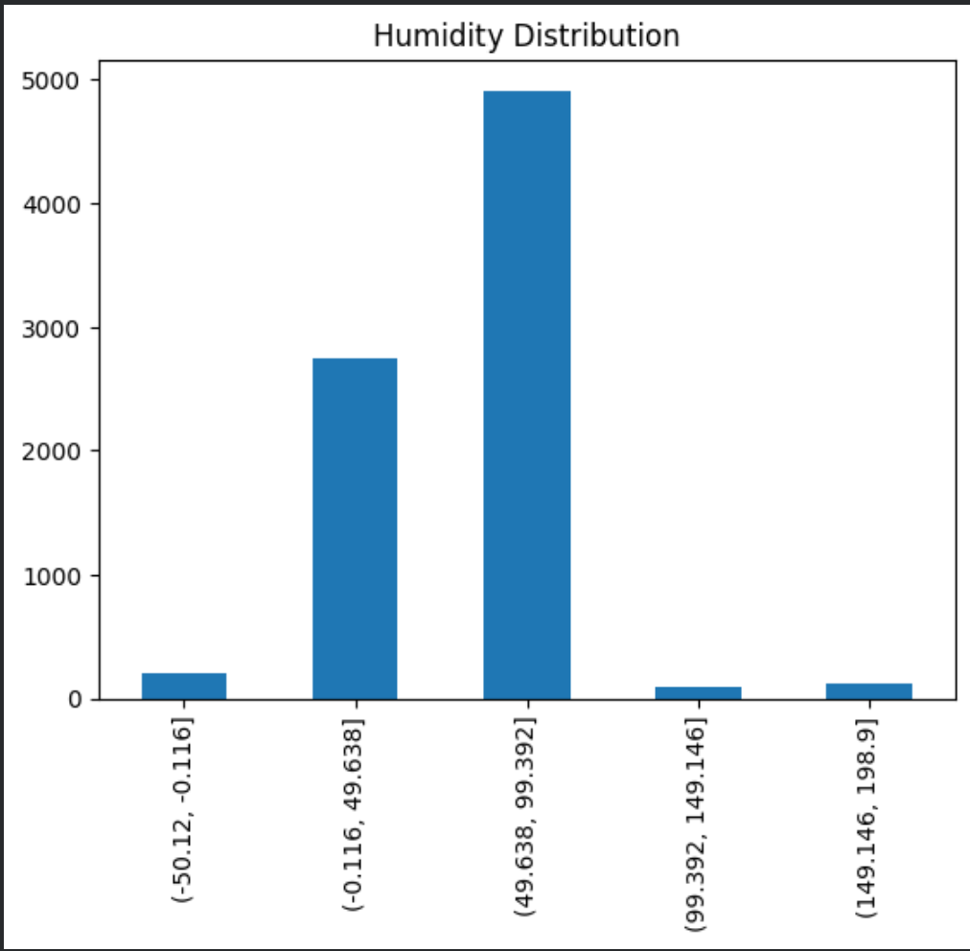
Humidity
This chart shows the distribution of humidity data grouped into five ranges. The vast majority of the observations fall into the middle ranges—specifically between -0.116 and 99.392—with the highest concentration (nearly 5,000 counts) sitting in the 49.638 to 99.392 bracket.

Slide 7
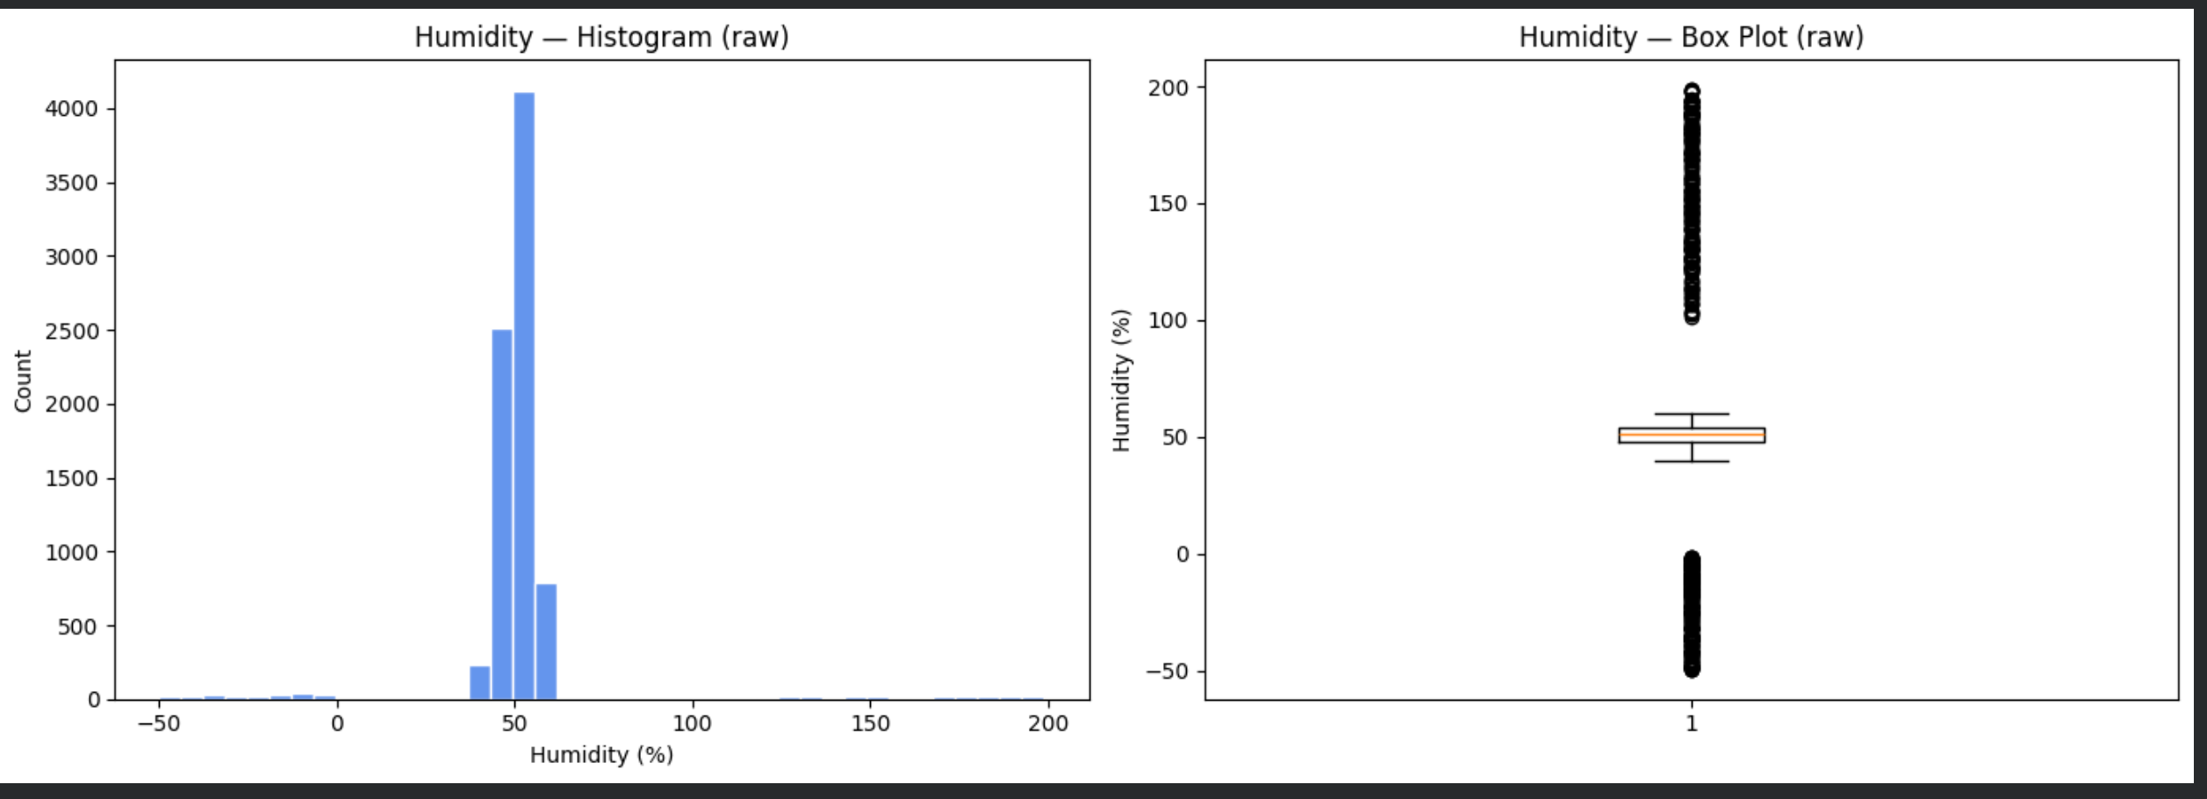
HUMIDITY

Slide 8
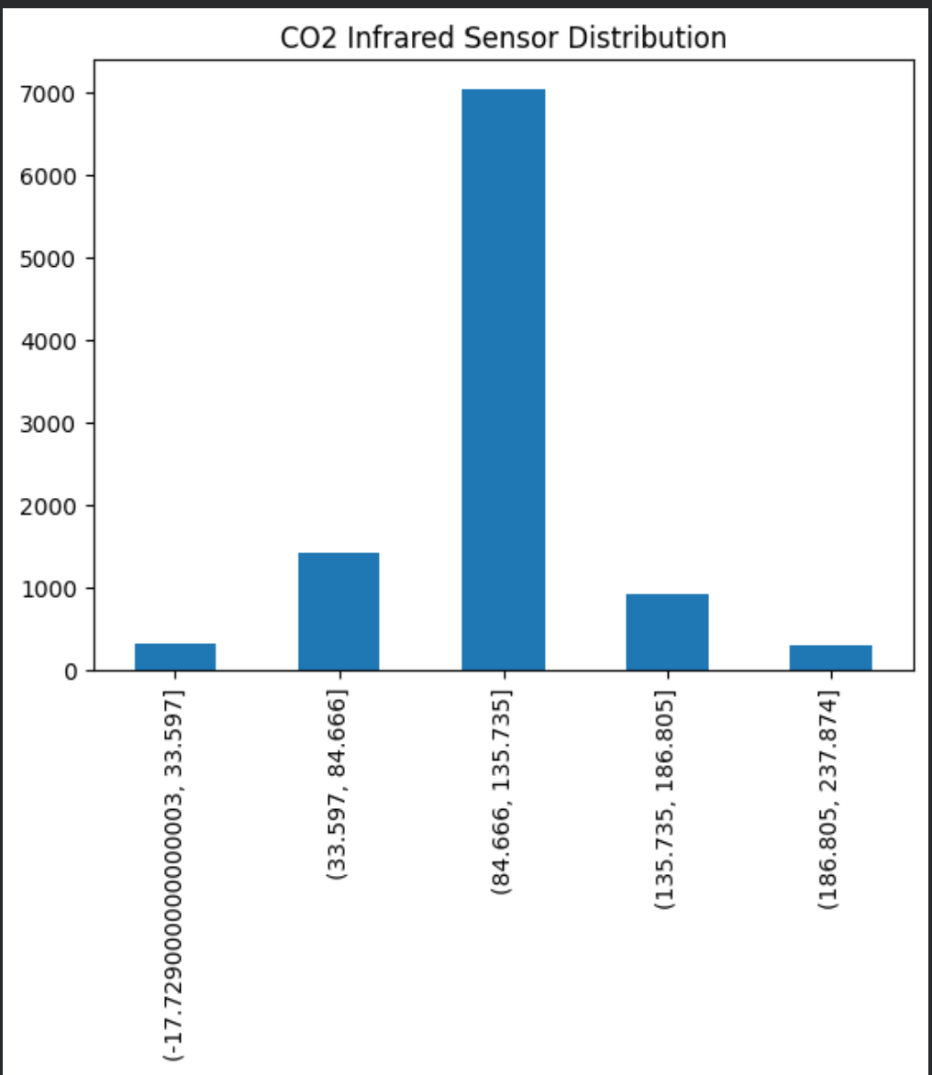
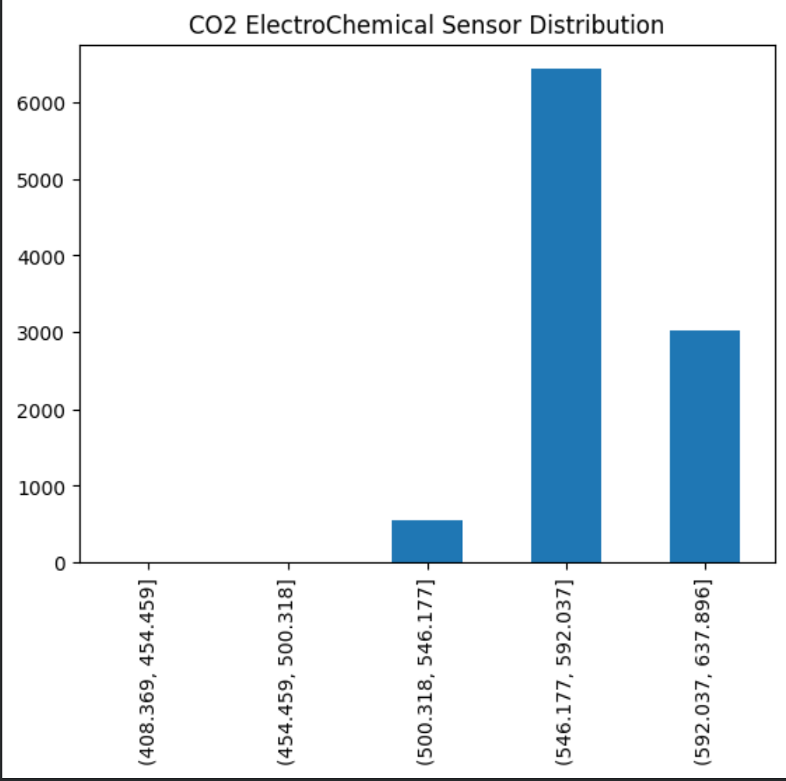
CO2 INFRARED AND ELECTROCHEMICAL

Slide 9
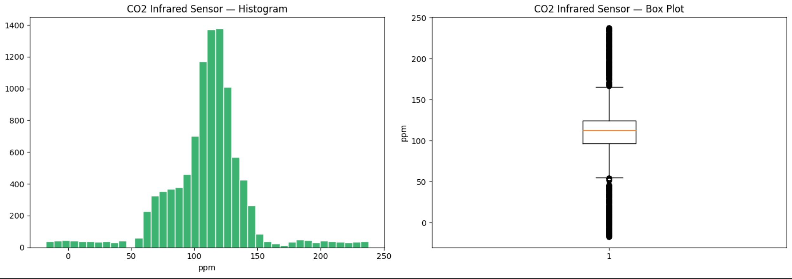
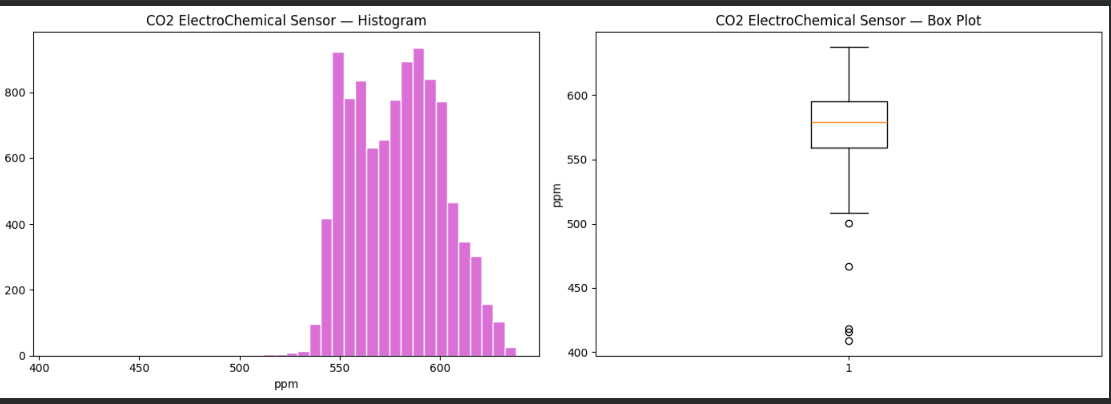

Slide 10
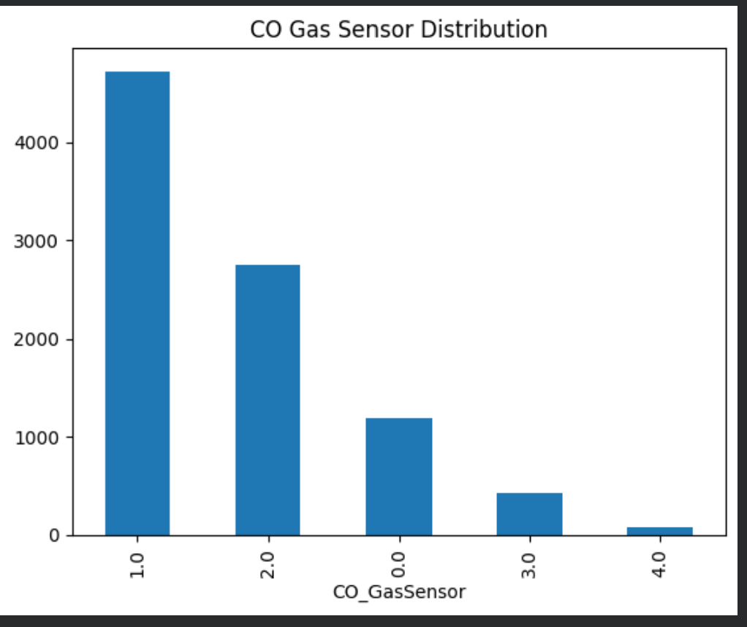
CO2 GAS SENSOR
This chart illustrates the frequency distribution of different categories or states registered by a CO (Carbon Monoxide) Gas Sensor. Unlike the previous continuous histograms, this data is categorical or discrete (labeled 0.0 through 4.0), sorted from most frequent to least frequent. State 1.0 is overwhelmingly the most common reading with over 4,500 occurrences, followed sequentially by 2.0, 0.0, 3.0, and finally 4.0 which has the fewest readings.

Slide 11
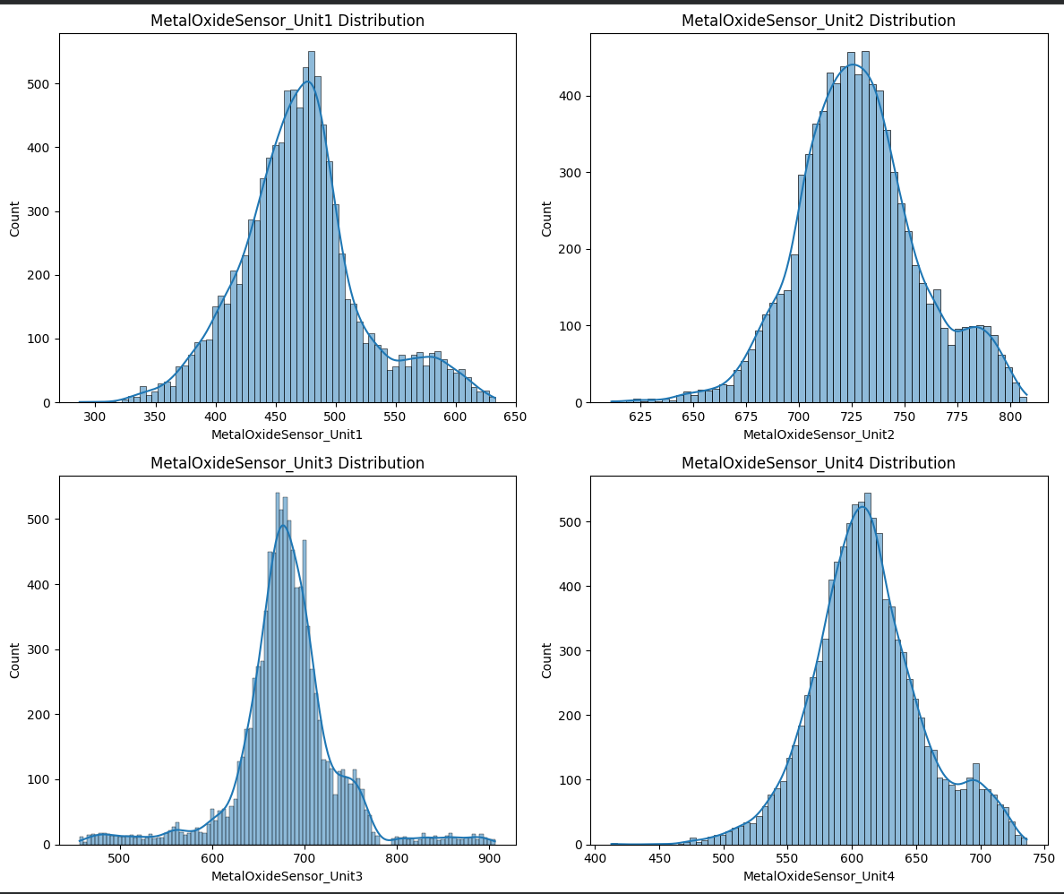
Metaloxide sensor
Combined together, these four visualizations represent a comprehensive exploratory data analysis (EDA) of an environmental or industrial monitoring dataset consisting of roughly 10,000 observations. The continuous variables display distinct structural patterns: Temperature is highly polarized (bimodal) between an extremely low and a very high range; Humidity clusters centrally between 0% and 100% (though it contains some out-of-bounds noise below 0 and above 100); and all four Metal Oxide Sensors exhibit similar bimodal distributions with a dominant primary peak and a smaller secondary shoulder. Meanwhile, the discrete CO Gas Sensor tracking categorizes the data into five sequential operational states, heavily dominated by state 1.0.

Slide 12
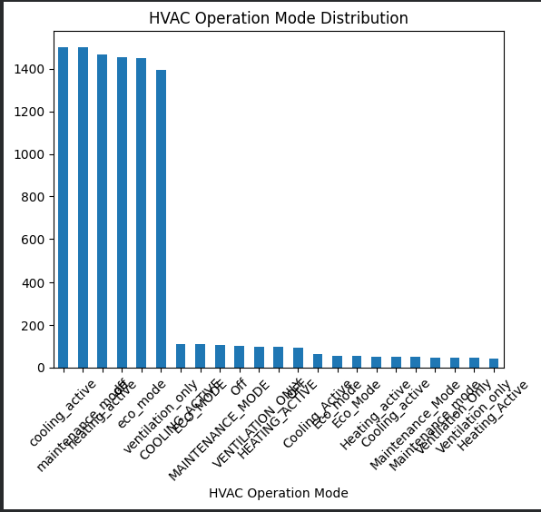
hvac
This bar chart illustrates the frequency distribution of different HVAC Operation Modes within the dataset. It reveals a highly imbalanced categorization dominated by six main operational states (cooling_active, maintenance_mode, heating_active, eco_mode, ventilation_only, and another eco_mode variation), each registering roughly 1,400 to 1,500 occurrences. The remaining categories appear significantly less often, each dropping to a count of under 200. Additionally, the data suffers from inconsistent naming conventions and duplicate labels with varying casing (e.g., cooling_active vs COOLING_ACTIVE, eco_mode vs Eco_mode vs ECO_MODE), indicating a clear need for data cleaning and text standardization.

Slide 13
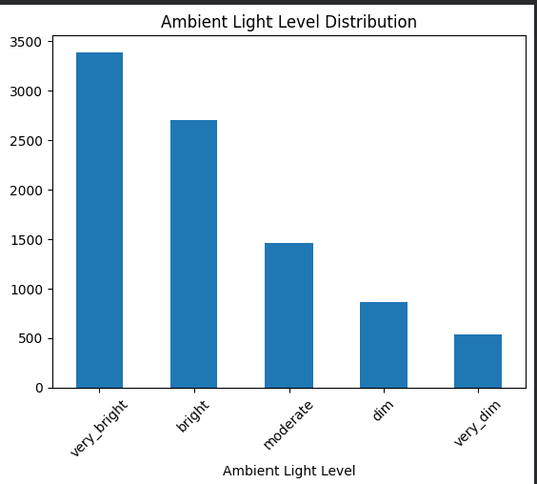
Ambient Light Level
This bar chart shows the distribution of Ambient Light Levels recorded across five distinct ordinal categories. The data follows a clear downward trend from left to right, meaning that brighter conditions are much more frequently represented in this dataset than darker ones. Specifically, the "very_bright" category has the highest frequency with over 3,300 counts, followed by "bright" (around 2,700), "moderate" (around 1,500), "dim" (around 850), and finally "very_dim" which has the fewest readings at roughly 500 counts.

Slide 14
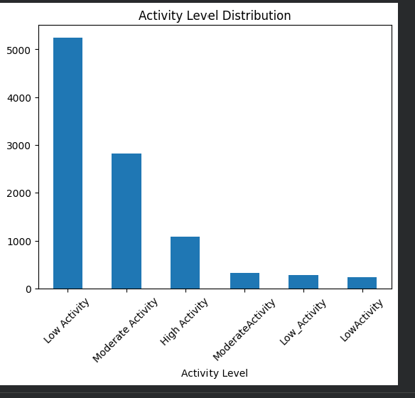
Activity level
This bar chart shows the distribution of "Activity Level" data across six categorical labels. The dataset is heavily skewed toward lower movement states, with "Low Activity" being by far the most frequent level at over 5,200 counts, followed by "Moderate Activity" (around 2,800) and "High Activity" (around 1,100). Similar to the HVAC data, this variable contains naming inconsistencies and duplicate categories with different formatting—such as "Moderate Activity" vs "ModerateActivity" and "Low Activity" vs "Low_Activity" vs "LowActivity"—that will need to be combined during data cleaning.

Slide 15
MODELS Justification

Slide 16
RANDOM FOREST
Random Forest is suitable for this problem because it can accurately classify elderly residents' activity levels using multiple environmental and air-quality sensor readings. It handles complex, non-linear relationships between sensor data and activity levels without requiring extensive preprocessing, while also being robust to noisy data. Additionally, it provides feature importance scores, helping identify which factors contribute most to activity level prediction.

Slide 17
K-Nearest Neighbors
K-Nearest Neighbors (KNN) is suitable for this problem because it predicts an elderly resident's activity level by comparing current sensor readings with similar past observations. It can effectively identify activity patterns from environmental and air-quality data without requiring complex assumptions about the data. By using the activity levels of the nearest similar cases, KNN provides a simple and intuitive approach for classification.

Slide 18
LOGISTIC REGRESSION
Logistic regression is suitable because the task is a multi-class classification problem that predicts elderly activity levels from sensor data. It can model the relationship between environmental factors and activity outcomes while remaining interpretable, helping identify key features. With proper preprocessing, it provides a stable and efficient baseline for early warning predictions.

Slide 19
How the models work

Slide 20
Random forest
An ensemble of decision trees tolerant of non-linear sensor interactions and resistant to noisy data (see Terms — Ensemble, n_estimators). Uses class_weight="balanced" (see Terms — class_weight) for class imbalance. Sweeps n_estimators 10 to 300, selecting the best value via macro F1-score.

Slide 21
K-nearest neighbors
A distance-based classifier that captures non-linear thresholds and sensor clusters (see Terms — GridSearchCV). StandardScaler prevents large-scale sensors from dominating distance (see Terms — StandardScaler). Tunes neighbor counts, distance metrics, and weight configurations via GridSearchCV with 5-fold CV and macro F1 scoring.

Slide 22
Logistic regression
A linear classifier valued for interpretability — coefficients trace which sensors drive predictions (see Terms — Multinomial, L2 regularization, Regularization strength (C), L-BFGS). StandardScaler ensures fair L2 penalisation (see Terms — StandardScaler). Uses class_weight="balanced" (see Terms — class_weight). Sweeps C 0.001 to 100 via macro F1-score, suppressing noisy features (Temperature, Humidity) while preserving sensor signal.

Slide 23
Clean.py
Input Processing: The clean_gas_monitoring() function takes the raw dataset and returns a cleaned version.
Invalid Value Detection: Unrealistic values (e.g., temperature > 60°C, humidity outside 0–100%, negative CO₂ readings) are identified and replaced with missing values (NaN).
Missing Value Imputation: Numerical features are filled using the median, while categorical/discrete features (e.g., CO_GasSensor, Ambient Light Level) use the mode.
Category Standardization: Different naming formats for HVAC operation modes and activity levels are mapped into consistent categories using predefined dictionaries.
Outcome: Produces a cleaner, more reliable, and standardized dataset suitable for further analysis and machine learning.

Slide 24
TUNING

Slide 25
Random Forest
Ensemble — A technique that combines multiple weak models (decision trees) to produce a stronger prediction. Random Forest builds hundreds of trees on random subsets of data and averages their outputs, reducing overfitting compared to a single tree.
n_estimators — The number of decision trees in the Random Forest. More trees generally improve performance but increase training time. RF sweeps this from 10 to 300 to find the optimal value.

Slide 26
K-Nearest Neighbors
GridSearchCV — An automated search that tries every combination of hyperparameters (e.g., different neighbor counts and distance metrics for KNN) using cross-validation, then picks the combination with the best score.

Slide 27
Logistic regression
Multinomial — A classification strategy that treats all classes simultaneously using a softmax function, producing a probability for each class that sums to 1.
L2 regularization — The default penalty in logistic regression. It adds the sum of squared coefficients to the loss function, penalising large coefficients and preventing overfitting. In scikit-learn 1.8, L2 is auto-selected when using the lbfgs solver — even though penalty='l2' is no longer written explicitly in code.
Regularization strength (C) — Controls how much the model is allowed to grow its coefficients by controlling the L2 penalty. Small C means strong regularization (simpler model, less overfitting); large C means weak regularization (more complex, can overfit). This is the primary tuning knob for LR.
L-BFGS — The default optimisation algorithm used by Logistic Regression. It iteratively adjusts coefficients to minimise the loss function (error + L2 penalty). Unlike tree-based models (RF) or distance-based models (KNN), LR needs an optimiser to find its coefficients.

Slide 28
METRICS

Slide 29
METRICS (ALL MODELS)
F1-Score — The harmonic mean of precision and recall. Unlike accuracy (which counts correct vs incorrect), F1 balances false positives and false negatives. This is our primary metric because it punishes models that guess the majority class and ignore rare but critical events. A high F1-Score means both precision and recall are strong — few false alarms and few missed detections.
Precision — Of all the times the model predicted a class (e.g. "High Activity"), how many were actually correct? High precision means few false alarms.
Recall — Of all the actual instances of a class, how many did the model catch? High recall means few missed events.
Weighted F1 (wtd) — Averages each class's F1 weighted by the number of samples in that class. This gives a representative view of overall performance since larger classes contribute more — if you randomly sample a prediction, this score reflects expected accuracy. However, because Low Activity makes up 57.7% of the dataset, a strong score on Low can mask poor performance on Moderate or High Activity. This is not ideal for eldercare where detecting rare events matters most. Weighted F1 is reported alongside macro F1 to give a complete picture of both per-sample and per-class performance. A high weighted F1 means the model performs well on the majority class (Low Activity), but can still miss rare events if macro F1 is low.
Macro F1 — While weighted F1 reflects per-sample accuracy, macro F1 tells you whether the model works for ALL classes. It averages each class's F1 equally regardless of sample count, so a low F1 on High Activity hurts the score just as much as a low F1 on Low Activity. This is the stricter metric used to select the best model, because detecting rare activity shifts matters most. Together with weighted F1, macro ensures the model performs well on common cases without ignoring the critical rare ones. A high macro F1 means the model performs well on ALL classes equally — harder to achieve but safer for eldercare, since a rare missed event is penalised as much as a common one.

Slide 30
Metrics used
For an eldercare early warning system, F1-Score is selected as the primary evaluation metric over standard classification accuracy due to inherent class imbalances in smart-home sensor logs. Because elderly residents spend a disproportionate amount of time resting, the dataset is naturally heavily skewed toward "Low Activity" instances. Relying on standard accuracy would reward a naive model that consistently predicts the majority class while failing entirely to catch critical movement transitions. F1-Score mitigates this bias by calculating the precision and recall for each activity class independently and taking their unweighted average. This ensures that "Low", "Moderate", and "High" activity states are treated with equal importance, directly penalizing the pipeline if it fails to accurately detect less frequent but potentially life-saving activity shifts.

Slide 31
COMPARISON

Slide 32
BEST MODEL

Slide 33
Thank you

